Slide 1
Assessing Risk on mobile, web-based and social media platforms
Presented by Global Threat Intelligence and Threat Management Center
July 2021
Operational & Technology Risk

Slide 2
It’s all about Risk
Most of Cyber Security work involves Risk; understanding it, assessing it, reducing it, or controlling it.
To help you gain a personal understanding of what this means, we’re focusing our talk today on a couple of things that you likely use everyday. We’ll going to assess risks that you’re exposed to when using a mobile device, apps or websites.
Notes:
For the purpose of todays’ conversation, Risk is any potentially unwanted consequence.

Slide 3
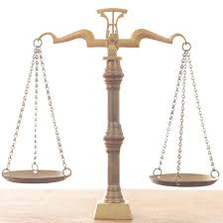
Finding the Balance
Or “Knowing your Risk Tolerance”
In most things in life, if there is a benefit, there is usually an associated risk.
For example, let’s look at cars -
Benefits Get were you’re going quicker Doesn’t take as much effort to cover distance. Take lots of things with you. |  | Risks Going faster, can’t stop? Accidents can be much worse Other drivers Pollution
Notes:
For the audience – any other benefits or risks come to mind?

Slide 4
Finding the Balance
Now, what about your cell phone?
Benefits You can always reach each out to someone Always know where you are (GPS) |  | Risks You’re always reachable Apps know where you have been
Notes:
Back to the audience – any other benefits or risks come to mind?

Slide 5
Assessing Risk
RISK
What might go wrong?
How likely is it? How bad could it be?
What can be done about it?
How do we keep track of this risk? Others?
Notes:
Each of these questions can be asked with a specific lens, or point of view, and that might change the answers you get….
Think about the point of view here and consider the car we mentioned earlier….
1) What if my brakes go out while I’m pulling into my driveway (Driveway flat vs driveway at a slant – up or down)
2) Could I do a risk assessment for the house itself that might cover this scenario?
Once Risk is identified, you may have choices - Risk Acceptance, Risk Mitigation, or Risk Avoidance
Now our next two speakers will dive into two popular apps and walk us thru a review of risk for the apps.

Slide 6
Risk Assessments: Instagram & TikTok

Slide 7
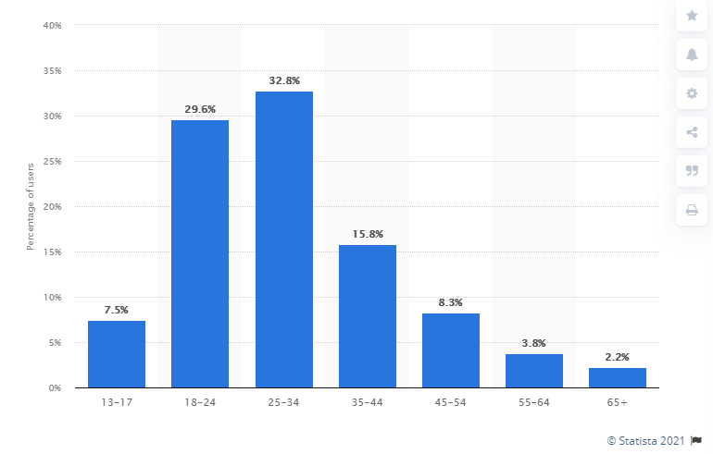
Instagram: What is it?
Instagram is an American photo and video sharing social networking. In April 2012, Facebook acquired the service. The app allows users to upload media that can be edited with filters and organized by hashtags and geographical tagging.
With roughly one billion monthly active users, Instagram belongs to the most popular social networks worldwide. The social photo sharing app is especially popular in the United States and India , both of which have nearly 140 million Instagram users each. In 2016 the platform added support for live video streaming.
Notes:
https://www.statista.com/statistics/325587/instagram-global-age-group/

Slide 8
TikTok: What is it?
TikTok is a social media application where users share videos between 15 seconds and 3 minutes long.
It is owned by Chinese company ByteDance, has over 100 million active users
TikTok’s algorithm tailors recommended videos to peoples’ “For You” pages using user location data, liked videos, and music
For most people, the app is a harmless way to share memories, funny moments, hobbies, and interact with your friends. From a cyber security standpoint, it poses numerous risks to personal information and safety.
Notes:
https://www.cpomagazine.com/data-privacy/is-tiktok-really-a-national-security-threat-new-report-from-university-of-toronto-says-no/
https://time.com/6071773/tiktok-faceprints-voiceprints-privacy/

Slide 9
Risk Management
Risk Acceptance
You accept all risks that come with engaging with any application or service. No actions are taken to reduce any risks associated with the platform.
Risk Mitigation
You take steps to reduce some of the risks associated with using the application or service. You implement compensating controls to reduce possible exposure.
Risk Avoidance
You refuse to take on any risks associated with the product. You delete all your data associated with an application and remove the application from all your devices.
It is important to understand that these options all require an understanding of the associated risks.
Notes:
Some methods for dealing with Risk once identified.

Slide 10
Risk Management – Video and Photo Sharing Applications
First and foremost, always make sure you know what information TikTok or Instagram is gathering from you. You can do this in your smartphone settings.
Consider the totality of the information you share in your content. Is it enough for someone to figure out where you live, work, or spend free time?
To protect against phishing campaigns, consider the types of communities you’re involved with on TikTok/Instagram. If it’s plausible that a third party could gather information on your age, interests, etc., use caution when opening emails and links from unfamiliar sources targeting you because of this information.
Notes:
https://www.wsj.com/articles/tiktok-user-data-what-does-the-app-collect-and-why-are-u-s-authorities-concerned-11594157084

Slide 11
Privacy Concerns - Instagram
According to a study earlier this year, Instagram topped a list of “invasive” apps that collect and share users’ data. The study found that Instagram collects 79 per cent of its users’ personal data and shares it with third parties, including search history, location, contacts and financial info.
Instagram is a huge financial success due advertising (the Stories feature it nabbed from Snapchat is now filled with it) and the data that powers all that advertising.
Instagram, through its integrations with Facebook, uses your personal information to show you ads that it believes you’ll be mostly likely to click on. This information comes from what you do within the app and Facebook, your phone and your behavior as you move around parts of the web that Facebook doesn’t own.
Notes:
https://www.wired.com/story/how-to-stop-instagram-from-tracking-everything-you-do/
https://www.independent.co.uk/life-style/gadgets-and-tech/instagram-invasive-app-privacy-facebook-b1818453.html

Slide 12
Privacy Concerns - TikTok
Everyone’s “For you” page on Tik Tok is different due to Tik Tok’s complex algorithm. Can you think of information that could be determined from your likes?
Age, location, interests, music taste, fashion choices, hobbies, phone usage, social groups -
In the background, Tik Tok is also gathering sensitive information:
This data includes device brand and model, Operating System version, mobile carrier, browsing history, app and file names and types, keystroke patterns or rhythms, wireless connections, and geolocation
To use the platform, users grant the app access to the microphone and camera. Multiple lawsuits allege that TikTok also collects biometric data from users, including facial geometry, iris scans, voice recognition, and fingerprints.
As a creator, landmarks, street signs, etc. can be used to determine physical location, workplace, patterns of life
Notes:
https://www.cisecurity.org/blog/why-tiktok-is-the-latest-security-threat/

Slide 13
Doing a Risk Assessment – Impacts/Mitigation
You read in the news that Instagram had a data breach. Photos, private messages and personal data were leaked for at least 30 million users.
You post a video from your vacation in NYC. The video is a highlight reel showing clips of the places you went: the Empire State Building, dinners, Central Park, etc. In the first highlight video, for less than a second, her flight ticket is visible. Your family is in the background of some of the videos as well.
You take some selfies at home with your dog and post it on your public Instagram.
You attend a concert with some friends. You livestream showing you and your friends. You tag each of them and hashtag the name of the event.
You run a coffee review page on Tik Tok, visiting many shops in Los Angeles, and trying some brews at home. In these videos, you include clips of your walks to the coffee shops, friends, and your kitchen. In some videos, your mom is working from home on her laptop, where the screen is partially visible.
You develop an interest in hiking. You and a friend start following local groups that get together for excursions that you plan on joining. You also start following influencers in the area, local outdoor shops, etc.
After you and your friend have gone on a couple of adventures with some local groups, some of the other members start tagging you in posts with details about upcoming trips. You comment that you can’t wait to tag along.
You post a video your basketball team dancing to a viral Tik Tok dance outside his high school gym. You tag your friends, and the name of your school is visible in the background of the video. You include in the caption that the state finals are next weekend at your school.
Notes:
Remember to ask: what can be done with this information?
You post a video from your vacation in NYC. The video is a highlight reel showing clips of the places you went: the Empire State Building, dinners, Central Park, etc. In the first highlight video, for less than a second, her flight ticket is visible. Your family is in the background of some of the videos as well.
What could someone do with this information?
You post a video your basketball team dancing to a viral Tik Tok dance outside his high school gym. You tag your friends, and the name of your school is visible in the background of the video. You include in the caption that the state finals are next weekend at your school.
What could someone do with this information?
You live in Cleveland and recently became really into knitting. You started following a lot of Cleveland knitters, interacting with their videos, and messaging other knitters on Tik Tok to get to know each other and share knitting tips.
What could someone do with this information?
You run a coffee review page on Tik Tok, visiting many shops in Los Angeles, and trying some brews at home. In these videos, you include clips of your walks to the coffee shops, friends, and your kitchen. In some videos, your mom is working from home on her laptop, where the screen is partially visible.
What could someone do with this information?

Slide 14
Risk Assessment: Password Managers
Notes:
Passwords are one of the common risks associated with almost all applications, websites and services.
Poor practices on the part of the service may wind up exposing your credentials (username & password), when this happens the threat actors (bad guys) frequently take them and try them in other places or services … hoping that you’ve reused the same password someplace else.
To avoid this risk, it’s recommended that strong, unique passwords and multi-factor authentication are used wherever possible.
However strong and unique pose certain problems…. Specifically, with producing them and then remembering them, which usually leads to the topic of Password Managers

Slide 15
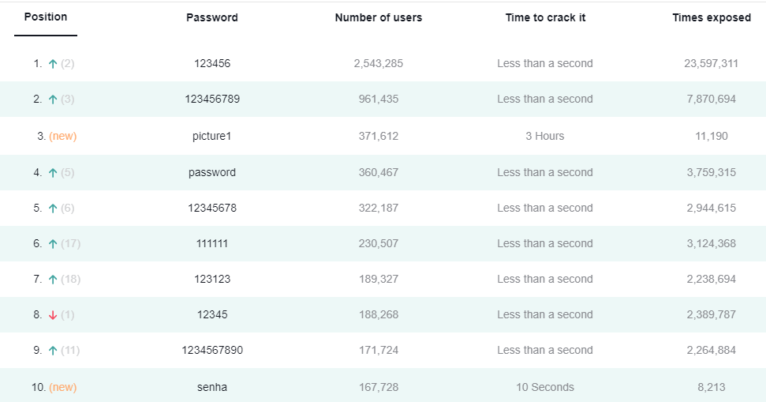
What is a Password Manager
A program or app that can assist with managing your passwords.
Can assist with creation of long complex passwords
Will store those passwords for later use, including automatically filling them into login pages.
Available for pcs, laptops, or mobile devices.
Depending on the manager, your passwords can be available on different platforms
If any of these look familiar you may benefit from a manager:
Notes:
200 most common passwords found in breaches, 2020 - https://nordpass.com/most-common-passwords-list/
Review of popular password managers - https://www.cnet.com/tech/services-and-software/best-password-manager/

Slide 16
Privacy Concerns
Pros and Cons….
Benefits Easy creation of strong passwords Less worry about forgetting passwords Secure storage (may be local or cloud) Can identify if passwords compromised Make it easy to update old passwords |  | Risks Single point of failure Target for hackers May not be easy to login using multiple devices. Passwords may not be securely encrypted Local Storage – can be accessed if you don’t have the file with you. Internet stored – may be targeted by attackers.
Notes:
There are no “sure things” here… you assess the risk, what is the most likely to impact you and take the steps you can to minimize the risk.

Slide 17
Risk Assessment Scenarios
What is the risk for you
Attackers getting hold of your passwords
You being locked out of a website or application
Your risk might not be mine.
My risk tolerance changes between work and home.

Slide 18
Ad Hoc Risk Assessment
Audience Suggestions
Please give us some examples to walk through
For discussion -
What are the benefits?
What are some risks?
What is your risk tolerance?
Should you accept, avoid, or take some action?
Any questions?

